Slide 1
Plan on spending about 10 seconds here to mention the names of your organization and your primary and secondary technical POCs..
OGC ISG Sprint Kickoff Presentation: InfoDao LLC |
Joshua Rentrope, Co-Founder
September 1, 2020

Slide 2
Intro
.Background: Machine learning and AI pipelines
.Our contribution will be in the Collections and 3D Containers portions of the GeoVolumes spec
Finding ways of appropriately structuring data within GeoVolumes
Developing techniques to interoperably handle data fusion
Specifically covering Scenarios 2 and 3
How multiple datasets can be combined (Scenario 2)
Identifying the computational impact of the spec on data fusion (Scenario 3 & stretch goals)

Slide 3
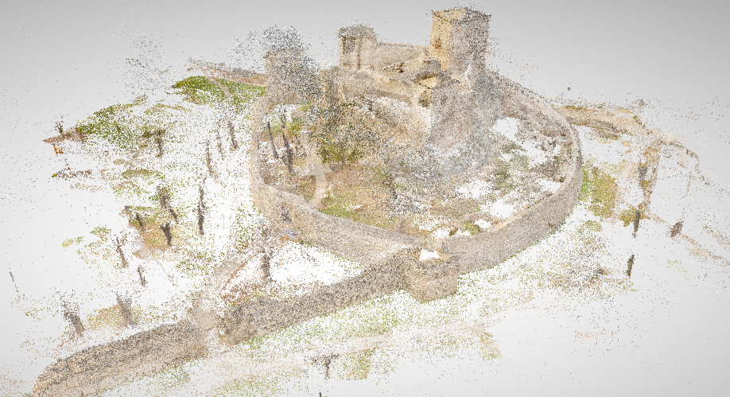
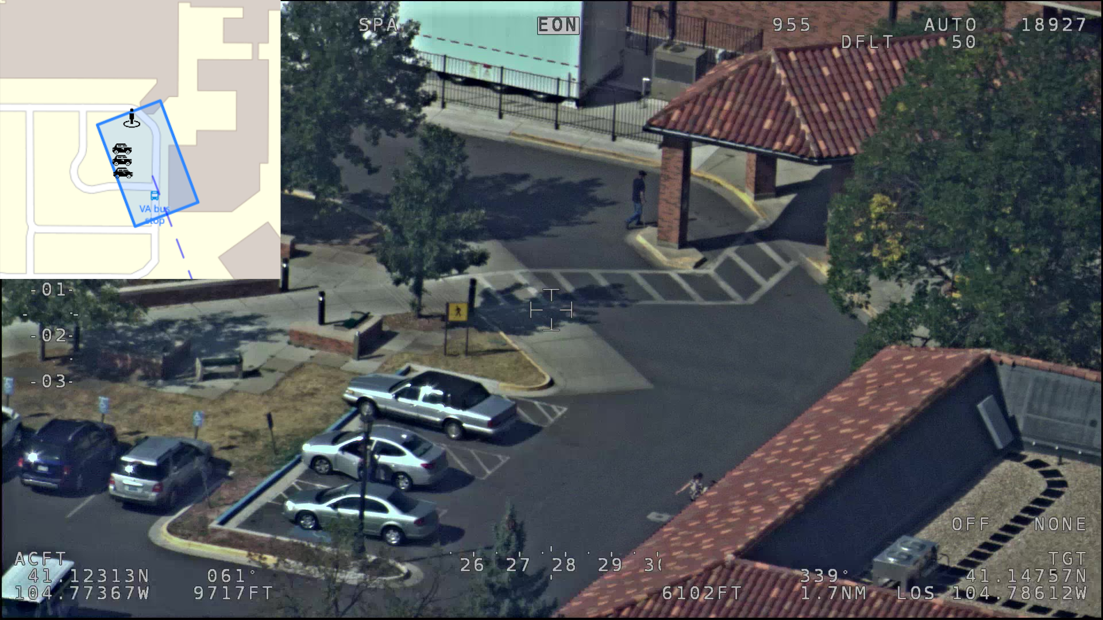
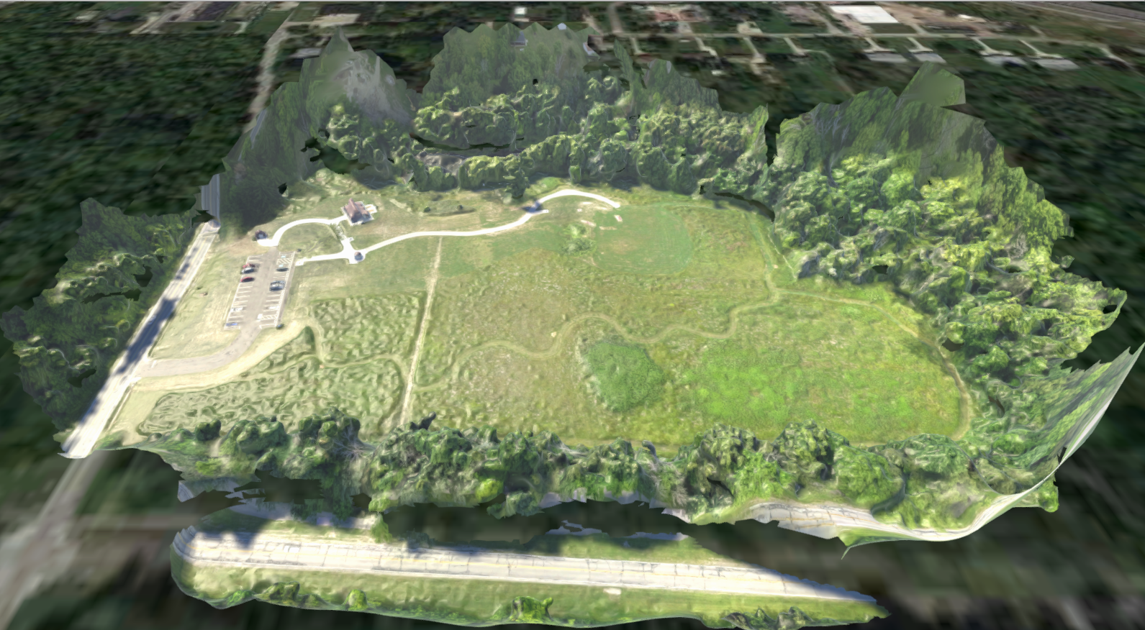
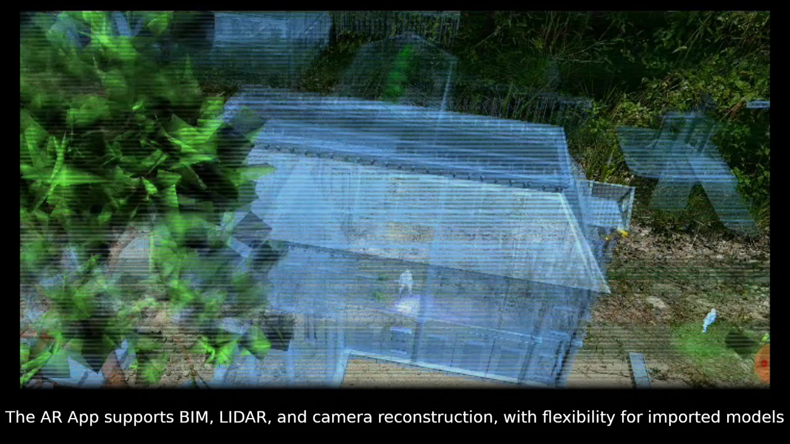
Prior Work

Slide 4
Wrapping it up
Please add any long or non-urgent questions as new issues in the GitHub repo (https://github.com/opengeospatial/OGC-ISG-Sprint-Sep-2020).
For further information about InfoDao visit the following links:
https://www.ogc.org/.
https://infodaollc.com/isg-sprint

